Slide 1
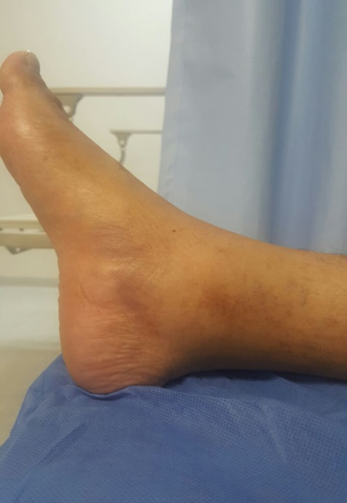
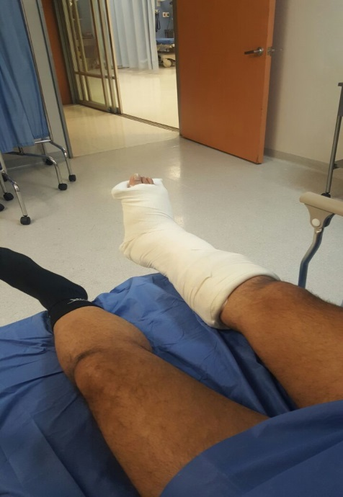
HS&E INCIDENT BULLETIN |  | 2nd half year 2016
Mexico | Type of incident (Ankle Fracture – Slip, Trip and Fall)
Summary:
An employee was descending from the third level of the compressor to the second level on the stairs located on the west side of the offshore platform. While going down last step his foot came in contact with a scaffold tube that was sticking out onto the step. This caused the employee to stumble causing injury to his right ankle
Root Causes: | Actions Taken Thus Far: Next Steps
Lack of warning that the scaffold tube was protruding between the third and last steps of the stairs. Lack of recognition of the associated hazards present. | After the accident a customer employee went to remove the scaffold tube sticking out. A safety stand down for all Mexico FSR occurred. Incident Investigation still in progress.

